Slide 1
MULTI-CUT REBAR(7)
Advisor : Prof. K.C.Chang
Presenters : You-Ran Nai

Slide 2
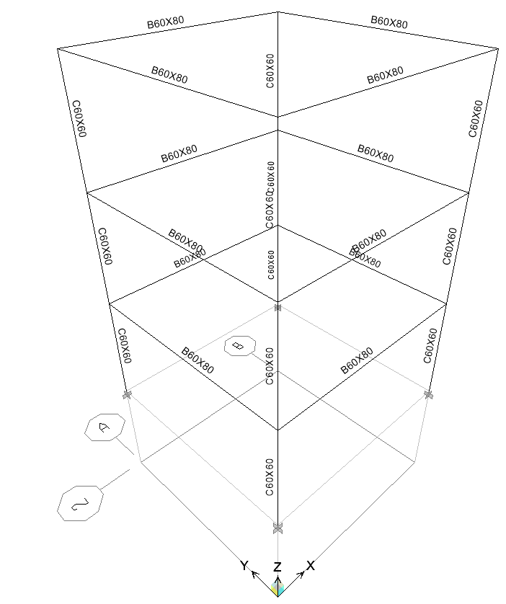
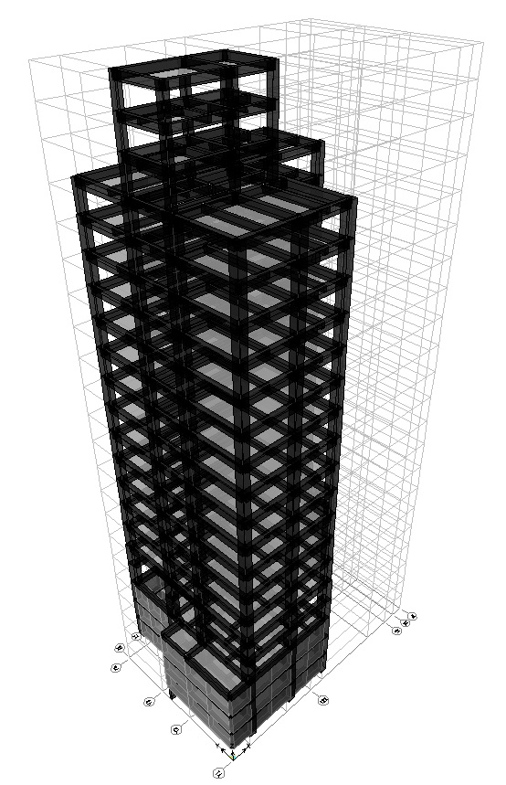
NONLINEAR VERIFICATION
3 STORYS, ONE BAY
HEIGHT: 9m
BEAM: 60x80cm
COLUMN: 60x60cm
SPAN: 8m
台北一區
I: 1.0
SDL:0.2t/m²
LL: 0.3t/m²
ACTUAL PROJECT
Notes:
驗證非線性
簡單 model => model 圖
實際專案

Slide 3
NONLINEAR VERIFICATION
BENCHMARK:
1st: FOLLOW IDA
2nd: FIRST MODE PUSHOVER
3rd : MPA, MMC, APA
Notes:
驗證非線性
簡單 model => model 圖
實際專案

Slide 4
Roadmap
NOW
NEXT
延伸長度考慮
雙箍面積
非線性 BENCHMARK
NEXT WEEK
NOW
五點斷筋
物流中心
剪力筋
施工成本

Slide 5
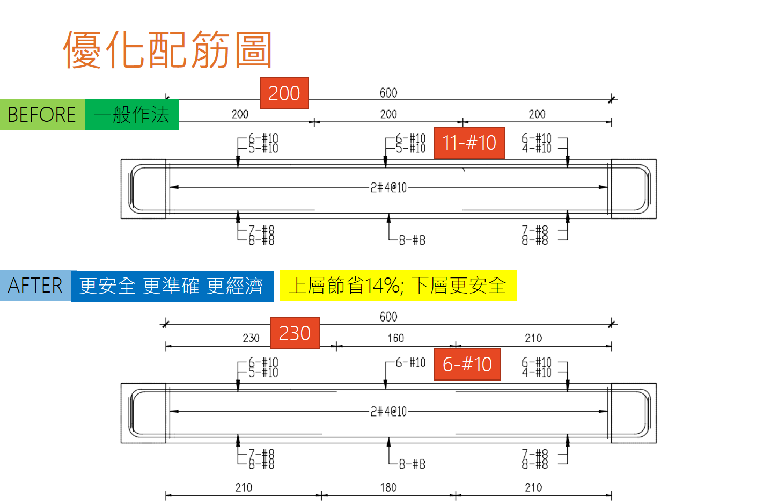

Slide 6
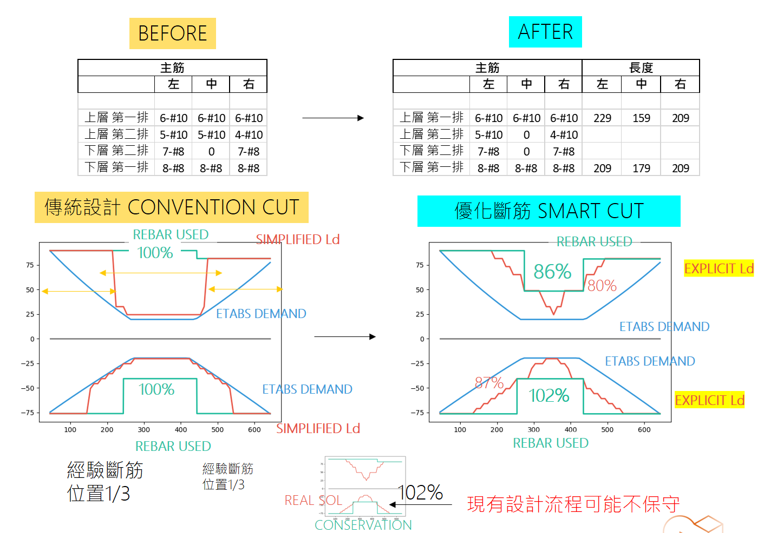

Slide 7
RIGOROUS
PROCEDURE
2
3
ETABS9
PYTHON
ETABS2016/SAP
MATLAB
IDA
ETABS DEMAND
MULTI-CUT
NONLINEAR HISTORY ANALYSIS
LINEAR
NON-LINEAR
1
4
EXCEL
VBA
ETABS9
PYTHON
MPA
MMC
APA
FROM EXISTING REBAR
MULTI-MODES PUSHOVER
ENGINEER
SIMPLICITY

Slide 8
RIGOROUS
PROCEDURE
2
3
ETABS DEMAND
MULTI-CUT
NONLINEAR HISTORY ANALYSIS
LINEAR
NON-LINEAR
1
4
FROM EXISTING REBAR
MULTI-MODES PUSHOVER
ENGINEER
SIMPLICITY

